Slide 1
WELCOME

Slide 2
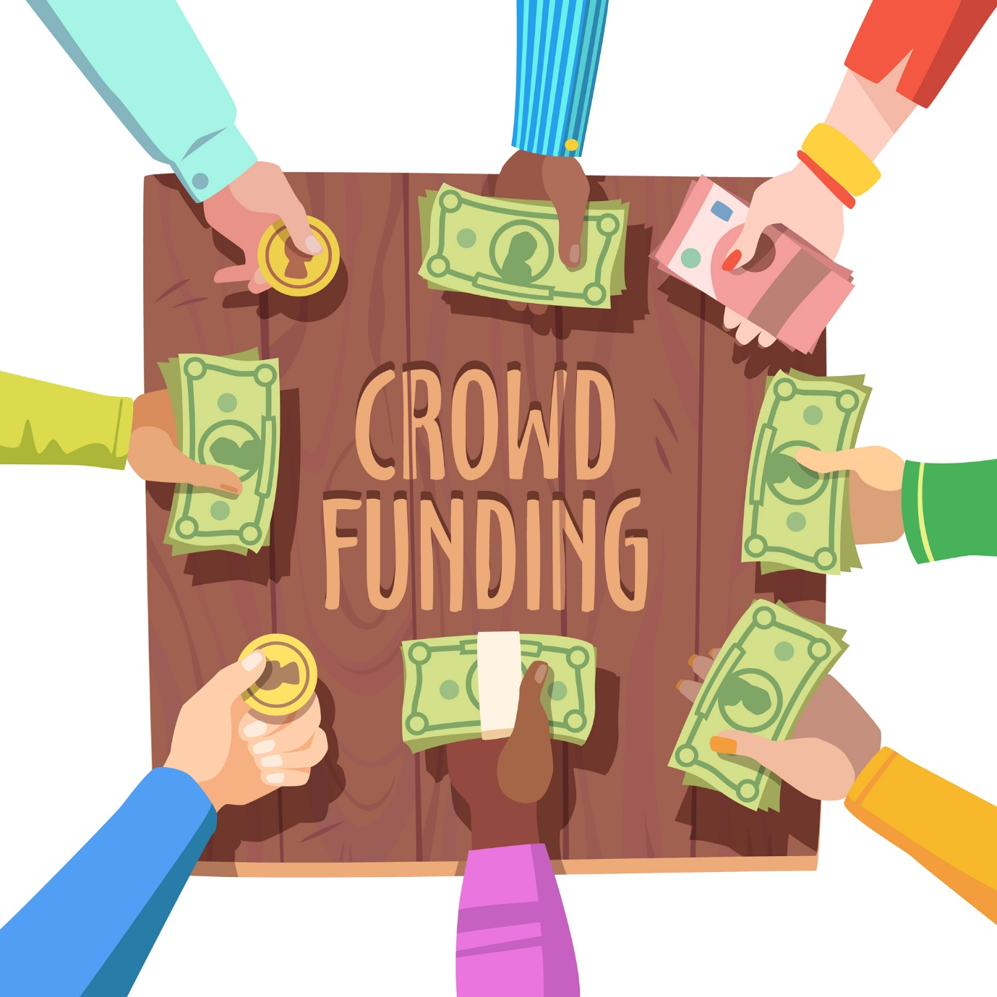
What is the crowdfunding
1.Crowdfunding is a way of raising money to finance projects and businesses. It enables fundraisers to collect money from a large number of people via online platforms. Crowdfunding is most often used by startup companies or growing businesses as a way of accessing alternative funds.
2. Crowdfunding is a form of crowdsourcing and alternative finance. In 2015, over US$34 billion was raised worldwide by crowdfunding.

Slide 3
What is Kickstarter:
1.Kickstarter is a funding platform for creative projects. Everything from films, games, and music to art, design, and technology. Kickstarter is full of ambitious, innovative, and imaginative ideas that are brought to life through the direct support of others.
2. Everything on Kickstarter must be a project with a clear goal, like making an album, a book, or a work of art. A project will eventually be completed, and something will be produced by it.
3.Kickstarter is not a store, backers pledge to projects to help them come to life and support a creative process. To thank their backers for their support, project creators offer unique rewards that speak to the spirit of what they're hoping to create.

Slide 4
How Kickstarter work:
Project Definition:
A project is a finite work with a clear goal.
Examples: albums, books, films.
Funding Goal:
The amount of money a creator needs to complete their project.
Funding on Kickstarter is all-or-nothing: no one is charged unless the project reaches its funding goal.
Ensures creators always have the budget they need before moving forward.
Creator:
The person or team behind the project idea.
Responsible for bringing the project to life.

Slide 5
Backers:
Individuals who pledge money to support the project.
Kickstarter is not a store; backers support a creative process.
Rewards:
Opportunities for creators to share pieces of their project with backers.
Typically include one-of-a-kind experiences, limited editions, or copies of the creative work being produced.

Slide 6
How Kickstarter Model Make Money:
1)If a project is successfully funded, Kickstarter applies a 5% fee to the funds collected.
2) All pledges are processed securely by our third-party payments partner, Stripe. ϒ These payment processing fees work out to roughly 3-5%.
3) View the fee breakdowns. ϒ If the project does not reach its funding goal, there are no fees

Slide 7
Challenges Faced During Project Development:
Team Coordination:
The primary challenge in the early stages of the project was coordinating with team members from diverse regions, languages, and varying working styles. Aligning different ideas and methodologies proved difficult, making it challenging to determine the right direction and resolve disagreements effectively.
Technical Challenges in Data Modeling:
One of the first technical challenges encountered was dealing with the large volume of data during the data modeling phase. Initially, we faced difficulties due to the absence of common columns, which hindered progress. After extensive work, we successfully established the appropriate relationships within the data.

Slide 8
3.System Performance Issues:
When developing the dashboard in Excel, our system experienced performance issues, causing it to hang due to the inability to handle large datasets. However, similar issues were not encountered with Power BI, Tableau, and MySQL.
4.Dashboard Development:
Determining the most important Key Performance Indicators (KPIs) for the dashboard was a complex task. Identifying relevant KPIs and ensuring their effective representation was challenging.

Slide 9
Insight From the Analysis:-
1.Total Projects and Outcomes:
1.Total projects: 365,846
2.Successful projects: 140,293
3.Failed projects: 188,239
4.Cancelled projects: 32,498
5.Suspended projects: 1,501
6.Purged projects: 178
2.The average duration for successful projects is approximately 79 days.
3.The total number of backers for successful projects is 18,380 M
4. Successful projects have raised a total amount of $16,041M
5. March has the highest number of successful projects with 11,993.

Slide 10
6. Year with Most and Least Successful Projects:
Most successful projects: 19,259 in 2024
Least successful projects: 576 in 2009
7.Top Project Categories by Amount Raised:
Tabletop Games: $9,794,000
Product Design: $9,320,000
Music: $7,996,000
Followed by: Shorts, Documentary, Art, Food, Film & Video, Video Games, Fiction
8.Top Locations by Number of Projects:
Los Angeles: 8,236 projects
New York: 7,153 projects
London: 4,848 projects

Slide 11
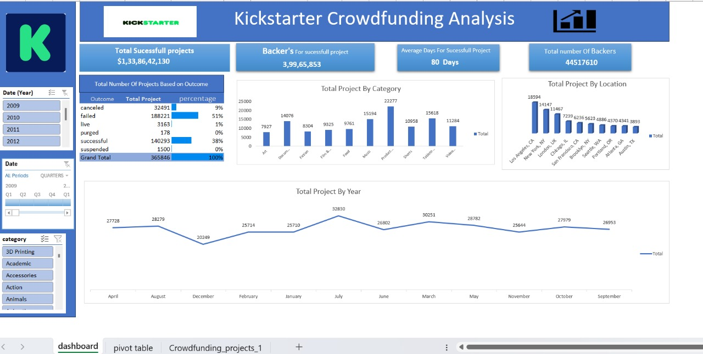
Excel Dashboard

Slide 12
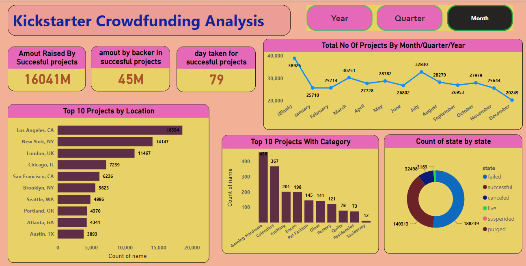
Power BI Dashboard

Slide 13
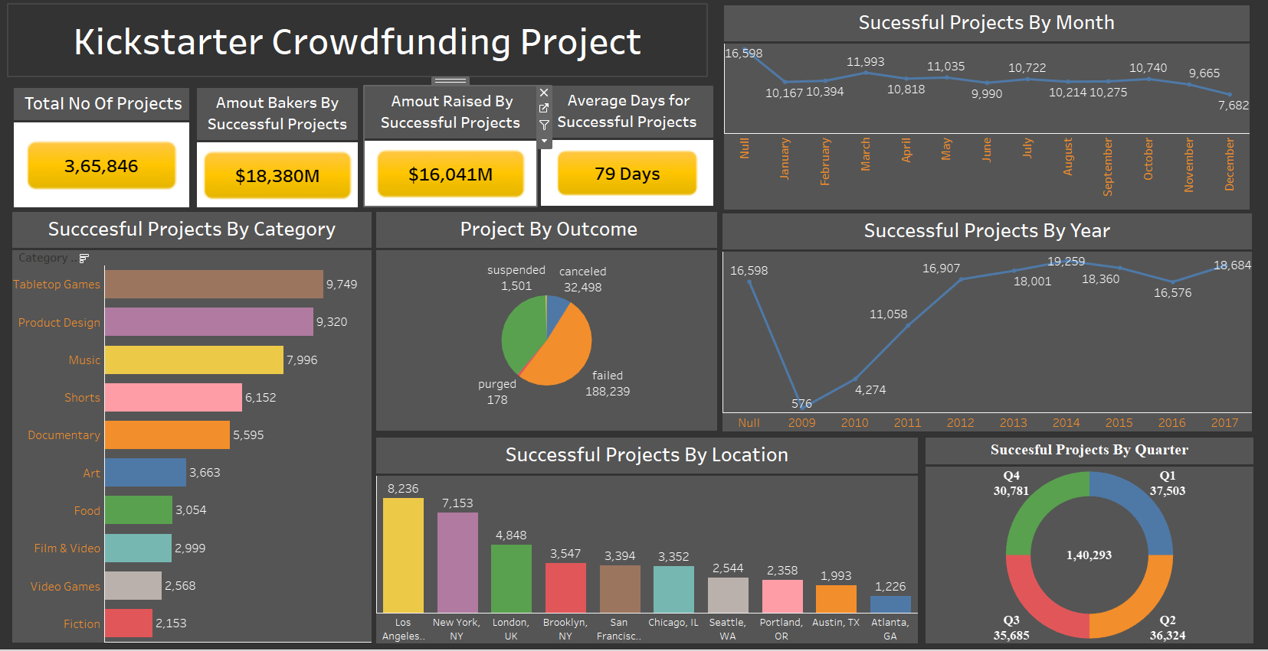
Tableau Dashboard:

Slide 14
THANKING YOU

